Slide 1
6 Month Committee Meeting April Peterson
5/28/2020
Payseur Lab
Notes:
-review main results from 2nd chapter
-present chapter 3 proposal
-timeline
Remember that for your committee meeting it will be important to motivate the work by identifying the main questions and describing the bigger picture.

Slide 2
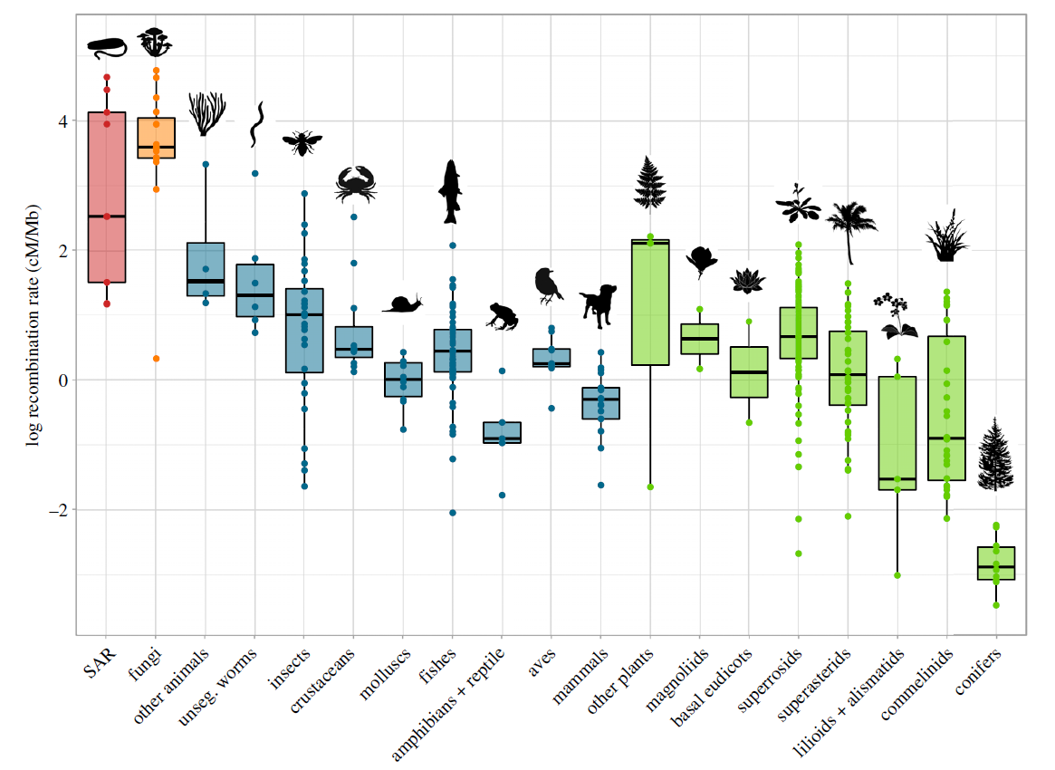
Variation in genome-wide recombination rates between and within species
Gruhn, Jennifer R., et al. PloS one 8.12 (2013).
Stapley et. al 2017
Notes:
Meiotic recombination rate is a fundamental genome parameter.
Meiotic recombination can affect how a population responds to selection and how the patterns of genetic variation are generated.
For many species it is a critical features for fertility. The crossovers generated through meiotic recombination are a major factor in ensuring proper chromosome segregation.
Despite these significant roles there is substantial variation within and across species in the average genome wide recombination rate.
One of the most consistent ways that genome-wide recombination rate varies is due to sex effects. Sexual dimorphism in recombination rate is known as heterochiasmy. It is still an open question as to how this pattern of sexual dimorphism evolves.

Slide 3
Major Questions: What are the evolutionary patterns of genome wide recombination rates (gwRR) variation at short time scales?
How do meiotic traits vary with genome wide recombination rate?
How do individuals vary in gwRR due to sex, genetics, or environment?
Aim 1: How much do individuals from a natural population vary in recombination rates?
Aim 2: How does genome wide recombination rate and related meiotic traits vary due to sex in the house mouse?
Aim 3: How do recombination rates vary between cells within an individual?
Notes:
Main questions for my thesis research
The major questions of my research are how recombination rates evolve and how factors of gametogenesis might be shaping the evolution of recombination rates in each sex. These are large complicated questions which needs to be broken down into smaller questions.

Slide 4
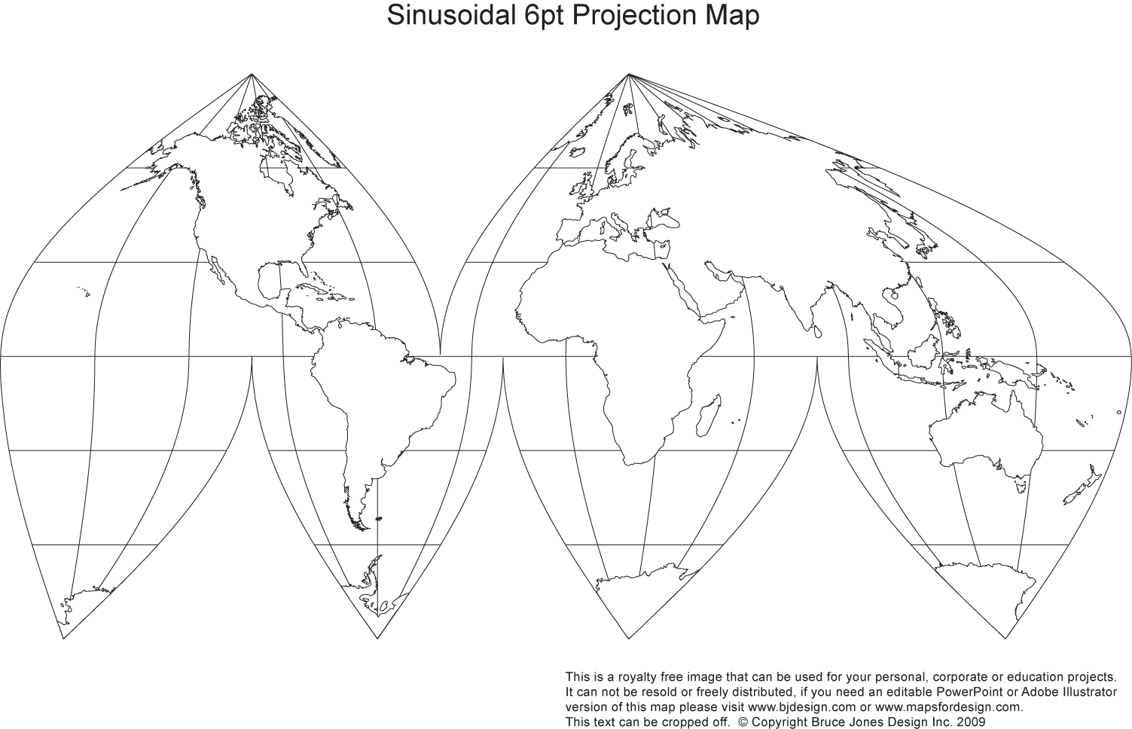
M. m. domesticus
WSB
LEWES
PERC
Gough
M. m. musculus
PWD
CZECH II
SKIVE
KAZ
TOM
M. m. castaneus
CAST
HMI
M. m. molossinus
MSM
MOLF
Mus musculus
Origin
Outgroups
Mus spretus (~3 mya)
Mus spicilegus (~3 mya)
Mus caroli (~5 mya)
Staining Approach
-Individual genome wide recombination rates (gwRRs)
- Single meiotic chromosomes
Notes:
1. house mouse is a great evolutionary model for looking at patterns which take place at a short evolutionary scale. the species complex formed about half a million years and being comensal with humans, natural populations have been established globally.
Using wild-derived strains sampled from natural populations raised in lab environment lets us quantify the genetic variation for recombination rate. This map shows the geographic origins of inbred mouse strains, most have not had not been quantified for recombination rate in both sexes. These strains also extend the geographic range from which previous recombination rate measures have come from. This panel of mice enables us to access a more complete picture of recombination rate variation for the species as a whole. Also I utilize measures from 3 outgroups.
2. I quantify recombination rates uses single cell antibody staining. This gives us an estimate of the genome wide recombination rate from a of cells. And also lets use look across meiosis timepoints and quantify single meiotic chromosome morphophy. By that I mean i use a software tool to quantify the length of synapsed homologs and the location of crossovers, shown in red and green.

Slide 5
Chapter 2, Sex-Specific Evolution of the Meiotic Recombination Rate
How does heterochiasmy evolve over short time scales?
What meiotic traits correlate with recombination rate variation?
-Rapid male-specific evolution of recombination rate in 3 strains; musculus^{PWD}, musculus^{SKIVE}, and molossinus^{MSM}. Enrichment of double crossovers (2CO) over single crossover chrms (1CO).
-Evolution increase double strand break in musculus^{PWD} and molossinus^{MSM} in early zygotene.
- Conserved sexually dimorphic traits:
1) Foci positioning differences and 2) Longer SC axis in females.
-Significantly stronger interference, via 2CO InterFocal Distance (IFD), observed in high recombining males.
Notes:
The distilled review for Chapter 2.
2. We ran the gwRRs from our panel of mice through a series of linear models which consistently nominated 3 strains as having significant male-specific evolution. Two strains are from the musculus subspecies and from molossinus which has a shares it’s genome with musculus. Most chromosomes have a single crossover, but these three strains have a significantly higher proportion of double crossovers. The increase in double crossover chromosomes translates to a substantial increase in gwRR compared to other strains within the same subspecies (up to 30% for MSM).
In females The general pattern is that the strain averages are much more similar compared to males. The scale of variation was much smaller and less consistent across the models.
3. Two of the high recombining strains had significantly more double strand breaks in an earlier stage of meiosis.
4. I identified 2 meiotic traits which were consistently sexually dimorphic in my measures and from the literature; CO position differences (telomere bias in males) and longer SC axis in females. While the direction and magnitude of sex differences for CO number can vary, these two traits have consistent sexual dimorphic patterns a wide range of species. There’s still an open question to how conserved these patterns are. The CO positioning differences is most widely supported (from plants, birds and mammals), observations of SC lengths sex differences are mostly limited to mice and humans measures. 5. We measured interference as the distance between two foci on the same chromosome (interfocal distance) and normalized for axis length. We found that interference was the only trait which correlated with increased genome wide recombination rate. For all three high recombination strains, we observed stronger CO interference. This goes against a simple expectation that more recombination in a genome would be more densely spaced and have a pattern of weaker interference.
<I'll stop for questions>

Slide 6
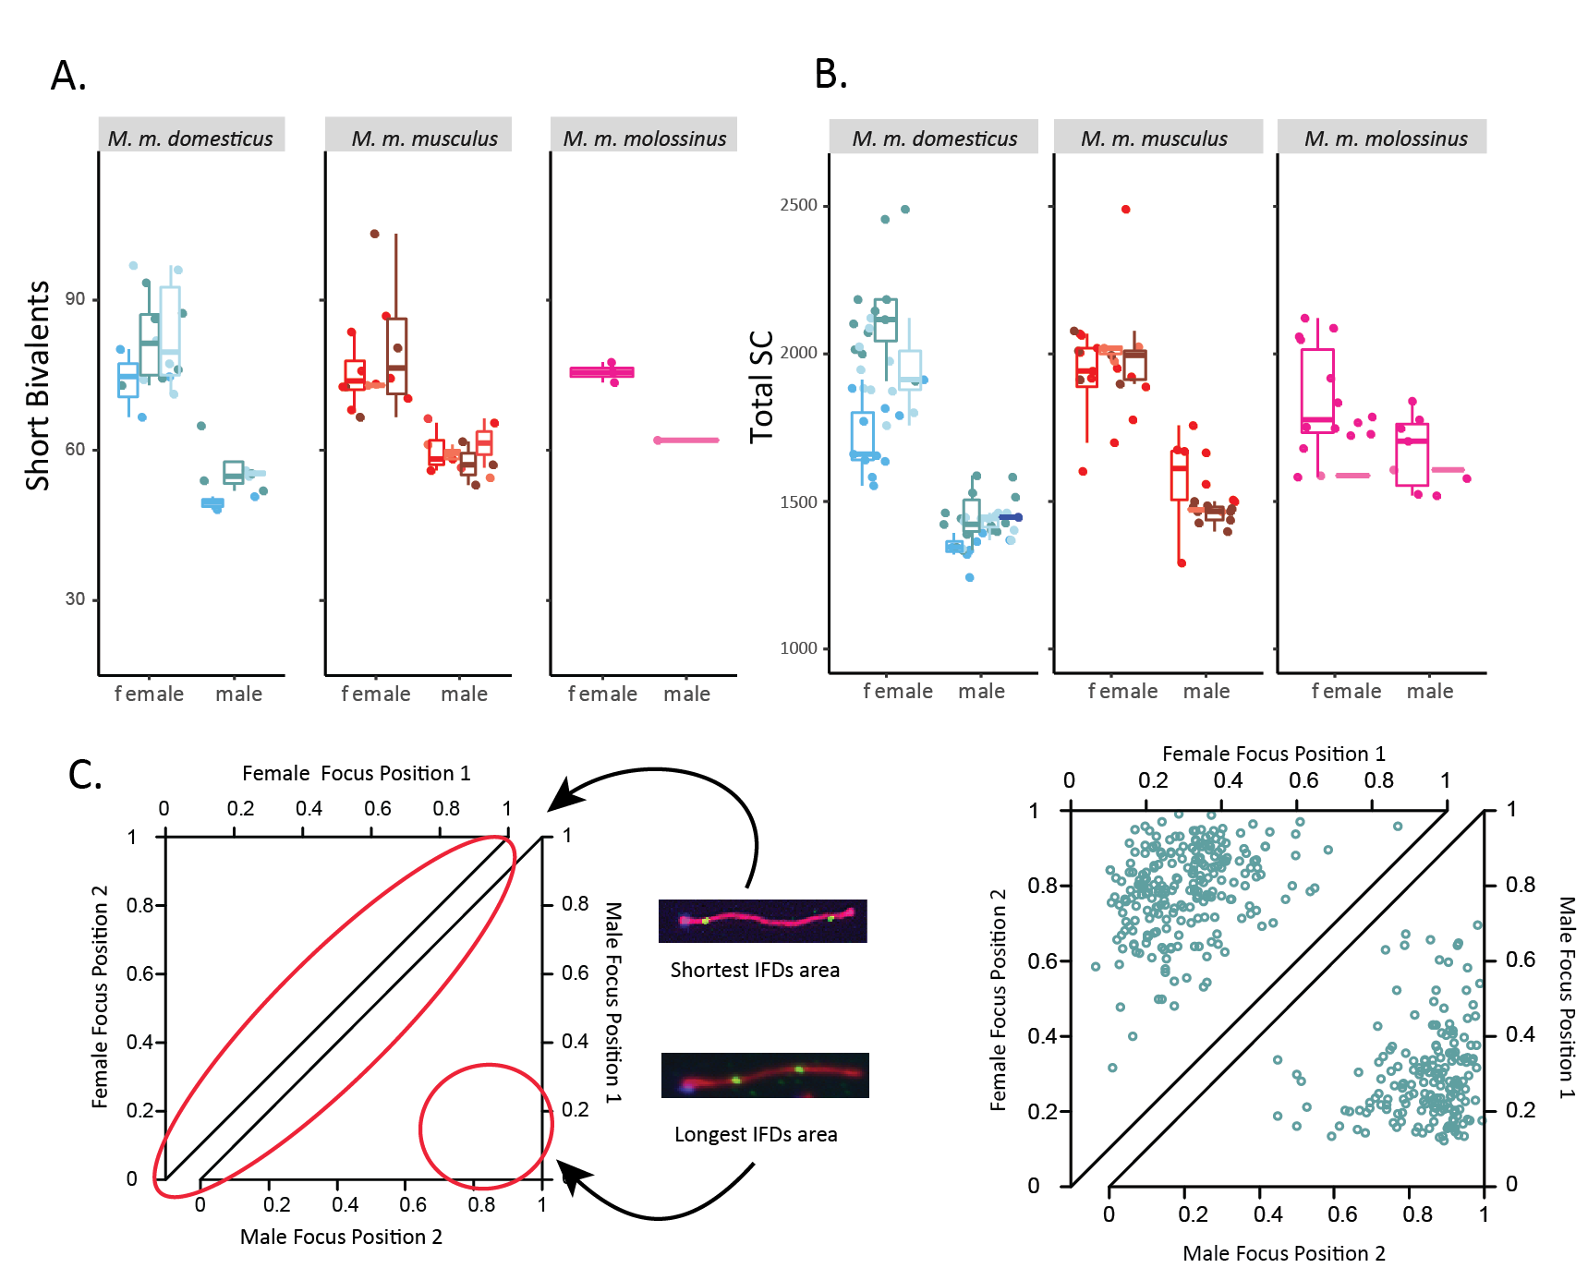
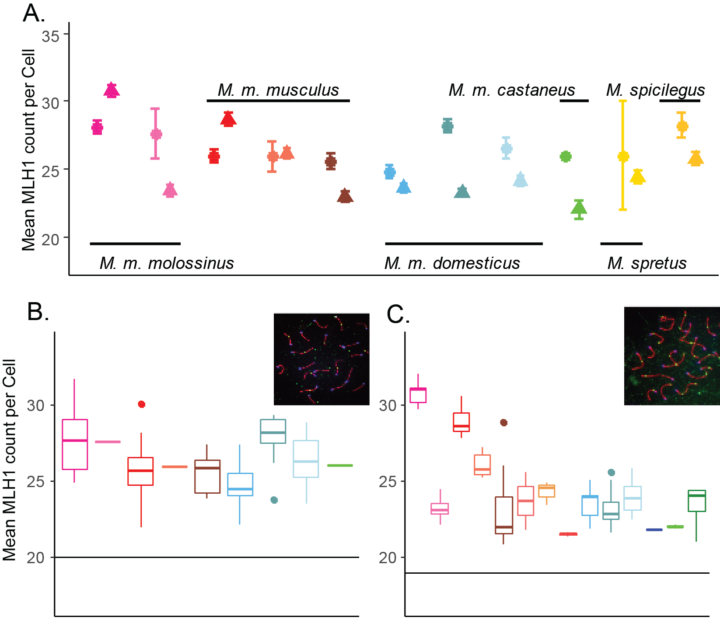
Chapter 2, Main results
MLH1 counts per cell
Short bivalent SCs
Total SC per cell
Female gwRR
Male gwRR
2CO
Interference
Patterns
Notes:
The large sample sizes for this study gave us confidence for estimating the general patterns
(sample sizes, ~100 mice for house mice
~2,000 cells total
~3,000 single bivalent measures

Slide 7
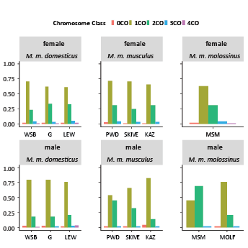
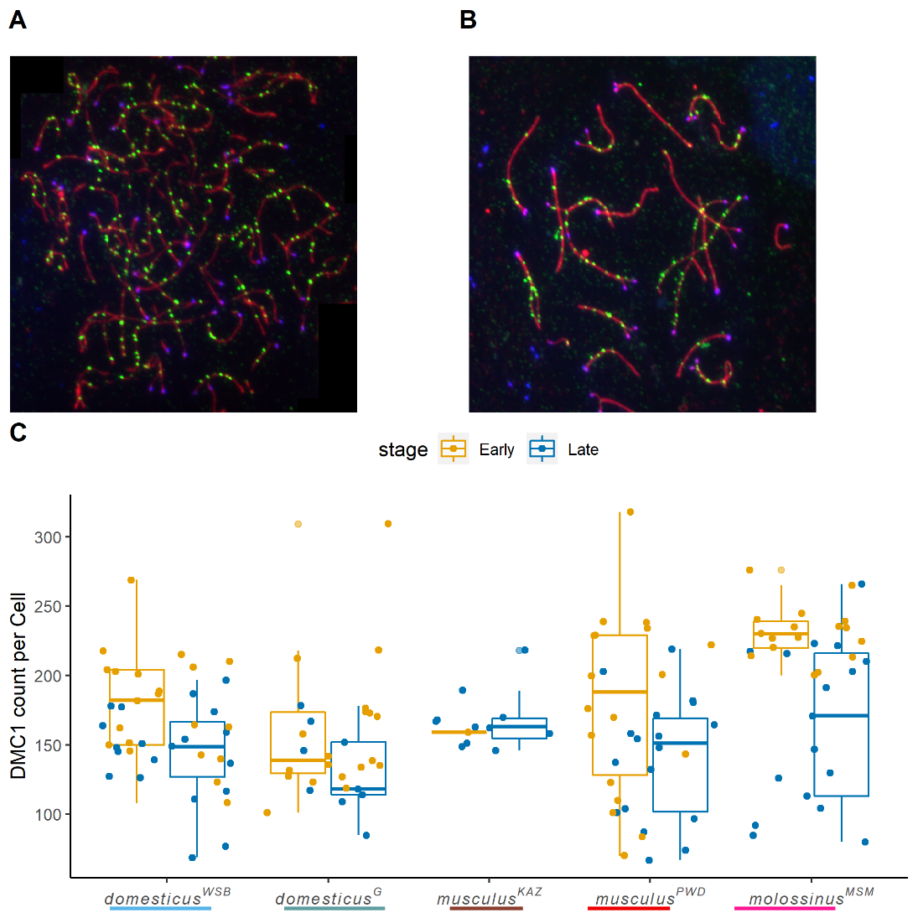
Notes:
CO-count per chromosome by bivalent class
DMC1 foci count comparison

Slide 8
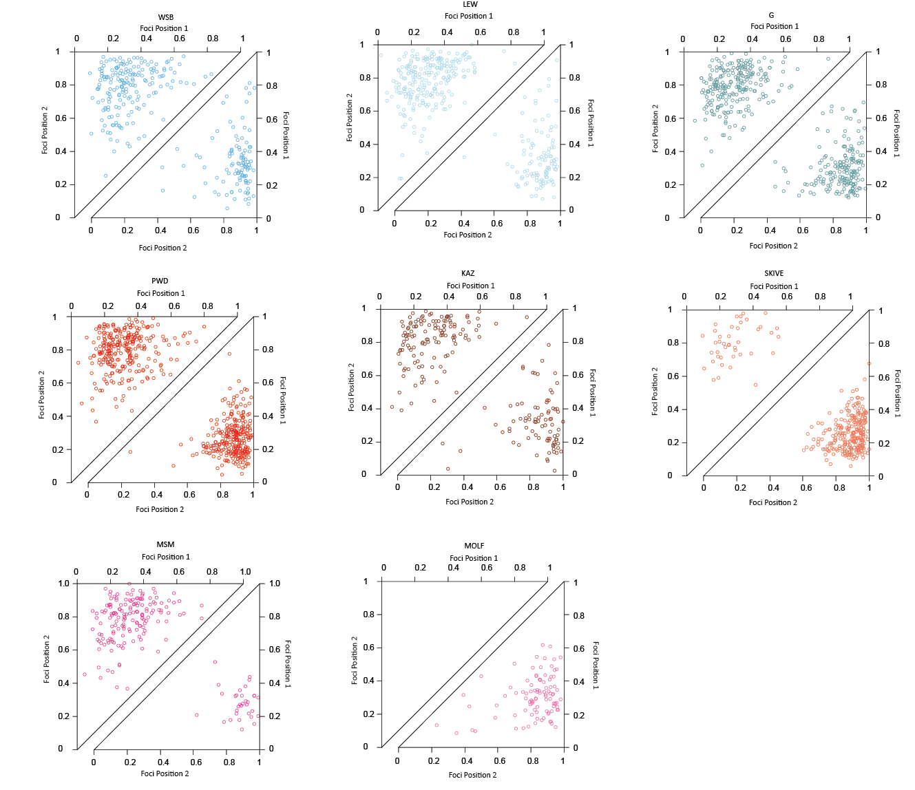
Notes:
Sex differences in 2CO IFD observations

Slide 9
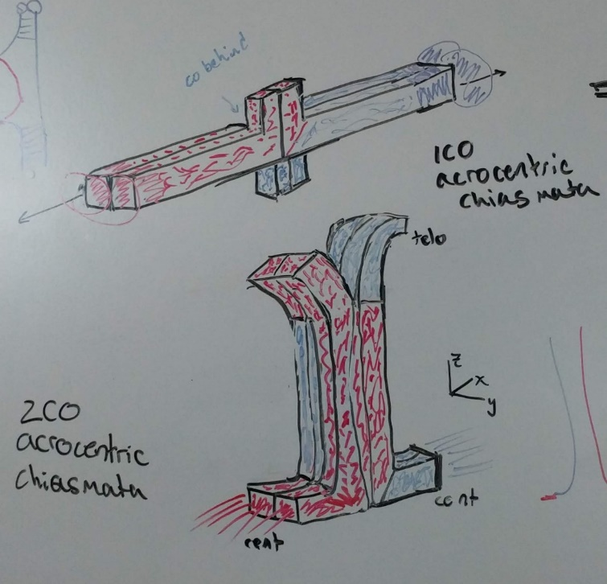
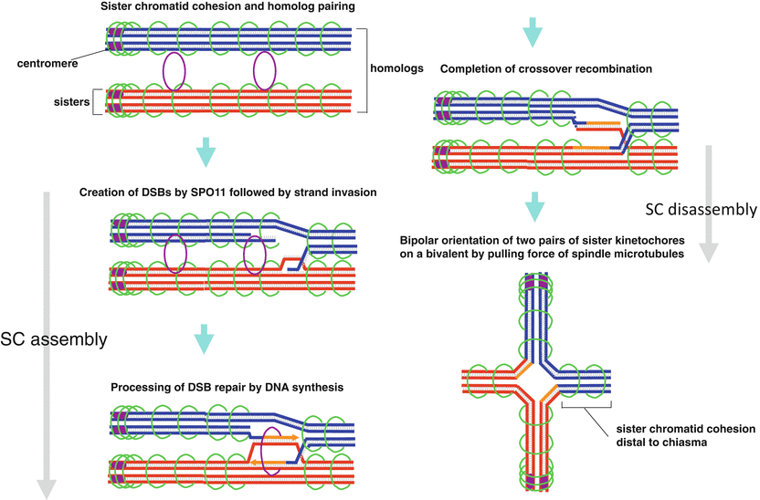
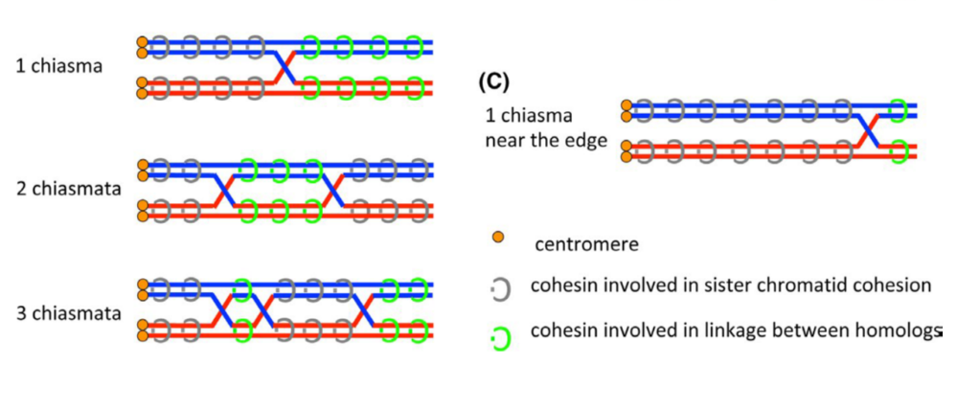
Chapter 2, Interpretations
Evolutionary models for sexual dimorphism evolution
Haploid selection (Lenormand 2003)
Meiotic drivers (Brandvain and Coop 2012)
Sexually antagonistic selection on coding and cis-regulatory regions (Sardell and Kirkpatrick 2020)
Spindle assembly checkpoint selection on recombination landscape
Sister-cohesion distal to chiasmata
1CO chromosome
2CO chromosome
Lee, J. (2020). Reproductive Medicine and Biology, 19(1), 32-41.
Notes:
1.To place our interpretations of all of these results within the context provided by the literature, We identified 4 evolutionary models and asked how many of these results would occur under their most basic expectations. We found that a spindle assembly checkpoint centered model was the most parsimonious.
2.(the logic for this model goes as follows) The spindle assembly checkpoint depends on tension created by the crossovers AND sister cohesin (forms structures called chiasmata seen below). This model centers on the fact the The number and placement of crossovers along synapsed homologs pairs affect the area of sister cohesin which will experience tension.
If the cell passes the SAC, anaphase initiates the homolog separation through regulated degradation of sister cohesin distal to the chiasmata.
It is known that The male SAC is more effective compared to the female, which results in sex differences in the effectiveness of selection against mutations to the recombination landscape that increase mis-segregation.
(this figure translates the 2D recombination landscapes to 3D bivalent structures)
The telomere bias of the male recombination landscape could speed up the separation or it could be a feature which synchronizes the separation for all the bivalents within a cell.
While a greater distance between two foci translated to more area of sister cohesin could create a more stable bivalent structure and somehow decrease the rates of chromosome missegregation.

Slide 10
Model | Reverse heterochiasmy direction Male > Female gwRR | Within mouse variance for CO number Eggs more variable than sperm in crossover per cell | Broad Scale Recombination Landscape Male telomere bias, Female uniform placement | Chromatin Compaction Female, longer axis Male, shorter axis | Evolution of positive correlation interference strength and CO number
Haploid selection (Lenormand, 2003; Lenormand and Dutheil, 2005) | No Generally males should evolve lower gwRR. | NA | NA No prediction for broad scale recombination landscape. | NA No prediction for chromosome axis. | NA
Two locus modifier (Brandvain and Coop, 2012) | Yes Depends on if rec. modifier: i) suppresses or increases recombination, ii) linked to driving loci, iii) the stage in which the driver acts (MI or MII) | NA | Yes Females will evolve higher RR and COs closer to centromeres to break up MI drive systems. | NA No prediction for chromosome axis. | NA
S.A.C.E. (Sardell and Kirkpatrick, 2020) | No Males should evolve to be lower gwRR. | Yes Maintaining regulatory and coding regions together lowers between cell variance in males. | Yes Maintaining larger blocks of chromosomes positions crossovers to telomeres. | NA No prediction for chromosome axis. | Yes Stronger interference is equivalent to larger blocks of chromosomes segregation together.
MI Spindle based selection (Altendorfer et al., 2020; Dernburg, 2001; Lee, 2019; van Veen and Hawley, 2003) | Yes More effective checkpoint (SAC) will cause faster evolution in males relative to females. | Yes Relaxed selection on SAC would increases variance across oocytes relative to spermatocytes. | Yes Telomere position of single crossover chromosomes maximizes sister cohesion with tension and may synchronize division of bivalents. | NA No prediction for chromosome axis. | Yes Amount of sister cohesion could: i) stabilize bivalents and allow SAC to detect tension or ii) regulate the timing of entry into anaphase via modulating the rate of degradation of the sister cohesion.
Pairing based selection, C.O.M. (Hultén, 2011) | NA No evolution predictions. | NA No prediction for between gamete variance. | Yes Difference of interference in sexes is due to axis length differences. | Yes Longer female axis driven by larger cell volume. | No No prediction for reduction phase.
Notes:
Comparison of results from to models of heterochiasmy and recombination rate evolution.
References:
Altendorfer, E., Láscarez-Lagunas, L.I., Nadarajan, S., Mathieson, I., and Colaiácovo, M.P. (2020). Crossover Position Drives Chromosome Remodeling for Accurate Meiotic Chromosome Segregation. Curr. Biol.
Brandvain, Y., and Coop, G. (2012). Scrambling eggs: meiotic drive and the evolution of female recombination rates. Genetics 190, 709–723.
Dernburg, A.F. (2001). Here, there, and everywhere: kinetochore function on holocentric chromosomes. J. Cell Biol. 153, F33–F38.
Hultén, M.A. (2011). On the origin of crossover interference: A chromosome oscillatory movement (COM) model. Mol. Cytogenet. 4, 10.
Lee, J. (2019). Is age-related increase of chromosome segregation errors in mammalian oocytes caused by cohesin deterioration? Reprod. Med. Biol.
Lenormand, T. (2003). The evolution of sex dimorphism in recombination. Genetics 163, 811–822.
Lenormand, T., and Dutheil, J. (2005). Recombination difference between sexes: a role for haploid selection. PLoS Biol. 3, e63.
Sardell, J.M., and Kirkpatrick, M. (2020). Sex Differences in the Recombination Landscape. Am. Nat. 195, 361–379.
van Veen, J.E., and Hawley, R.S. (2003). Meiosis: when even two is a crowd. Curr. Biol. 13, R831–R833.

Slide 11
Chapter 2, Summary
Considerations
- Fitness effects not measured
- Chromosome specific effects
- Type II COs
- Examined strains may not fully representative for house mice
1. Distinct evolutionary trajectories for sex specific genome wide recombination rates
2. Evolution of interference and genome-wide recombination rate at short time scales
Increased sampling of natural genetic variation from rare strains
Analysis of multiple meiotic traits
Examining recombination meiotic traits in both sexes
Notes:
1. We were aware of some caveats in this study,
- Fitness effects were not measured in this study (annueploidy rate, fertility) so we can’t make a direct connection to fitness effects
- We limited the data for single chromosome measures to reduce the noise from chromosome effects
- This approach misses a predicted ~10% of recombination events ( Type II COs)
- The strains we looked at might not be fully representative of house mouse species
2. Nevertheless We hope the impact of this paper to the field come from the 2 main findings of
The distinct evolutionary trajectories of genome wide recombination rate
(The evolutionary pattern we observe is consistent with relaxed selection in females -- and directional selection in males.) - Insights into the molecular pathway – DSB rate evolution, and crossover interference evolution can evolve rapidly (known for hotspots / recombination landscape )
Additionally these results are novel in that
-they provide novel measures from rare strains
-multiple meiotic traits were examined (and patterns synthesized across them
-both sexes were examined
New questions
Is the lack of male specific evolution in M. m. domesticus meaningful?
Additional strains for crosses future QTL mapping to identify genetic variants

Slide 12
Notes:
pause

Slide 13
Chapter 3, Variation in recombination rates across cells
Variance of a trait can shape the effectiveness of selection
Sex difference are mostly from humans and classical lab strains of mice
Approach
Var( CO count ), cV( CO count )
Similar glm framework from Chapter 2 + Permutations
Full and high quality cell datasets
Has between cell variance in CO count evolved in house mice?
human
Human
Gruhn, Jennifer R., et al. PloS one 8.12 (2013).
Notes:
While chapter 2 focused on means to describe sex differences in recombination rates, chapter 3 will focus on the variance in recombination rates. Sexual dimorphism is illustrated by these data from humans.
The driving question for this chapter is if there has been evolution of the variance for recombination rates in the same panel of mice.
The variance of a trait can shape the effectiveness of selection.
Previous measures of this trait are from female-biased heterochiasmy species, so measuring this in the male biased high recombining strains will provide insights into if the variance evolves with rapid evolution of gwRR
The approach for this chapter will be very straightforward. It will use the same linear model framework as chapter two – but for variance, cV. It will use a full dataset and a smaller higher quality subset of cells.

Slide 14
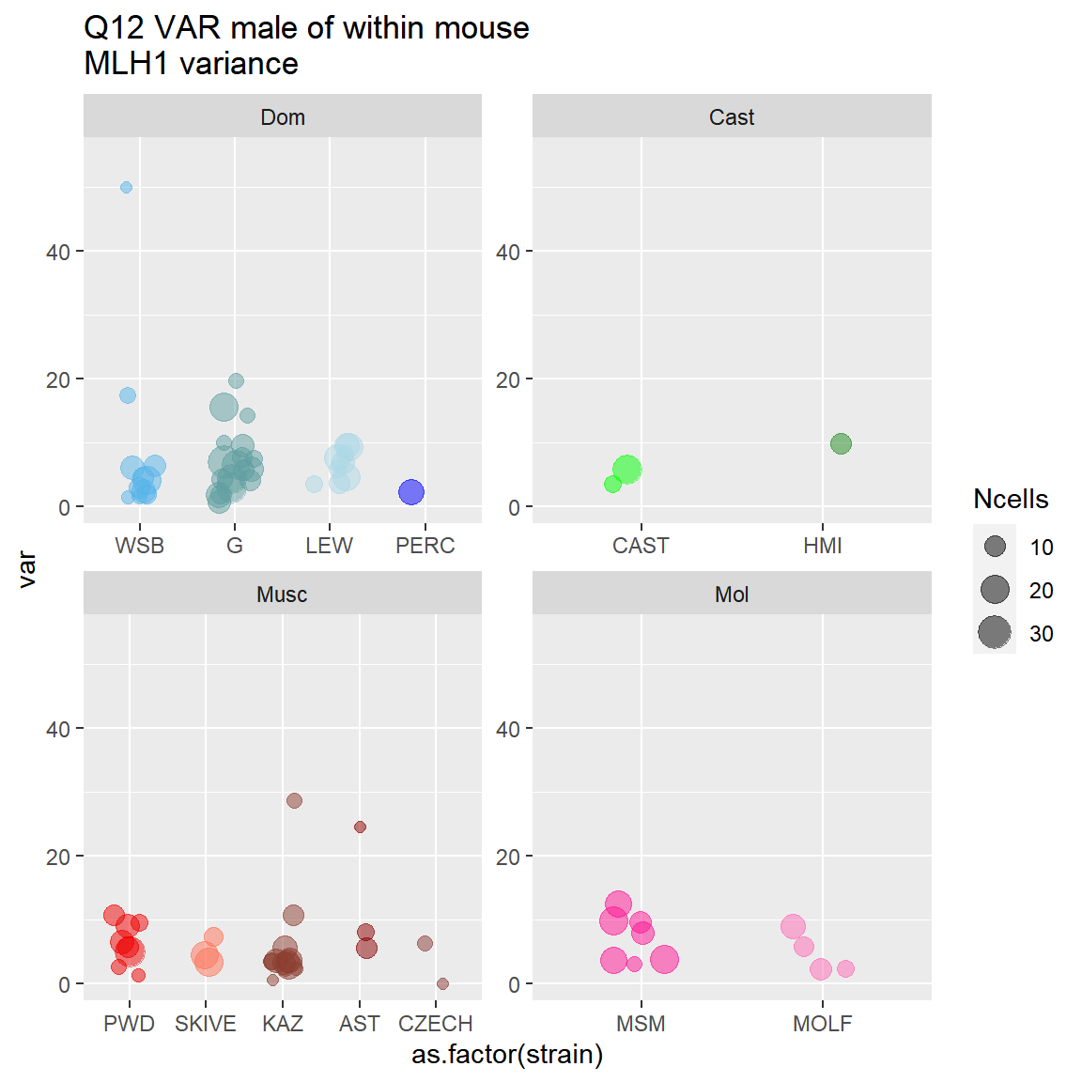
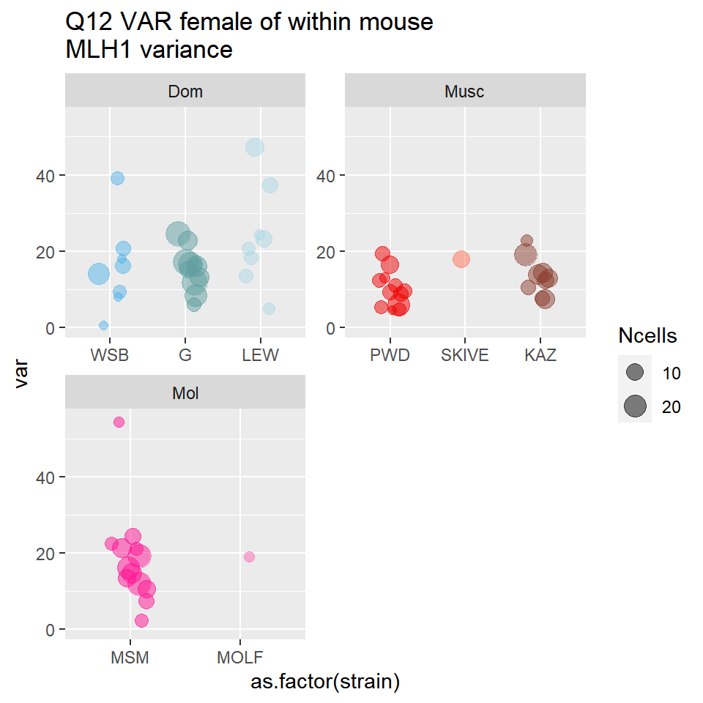
Chapter 3, Preliminary Results
Male variance
Female variance
Variance per Mouse
Variance per Mouse
Mixed model
Sex highly significant (p = 6.3110^{-8} )
Glms
Sex weakly significant effect (p =0.07)
Notes:
These are the mouse level values for variation in recombination rates calculated from the smaller dataset.
The general pattern seems to be that the female distribution is larger and the mean is higher.
Running these data through the models; sex was the only significant effect, highly significant in the mixed model and weakly significant in the glms. Results were similar for both var and cv.

Slide 15
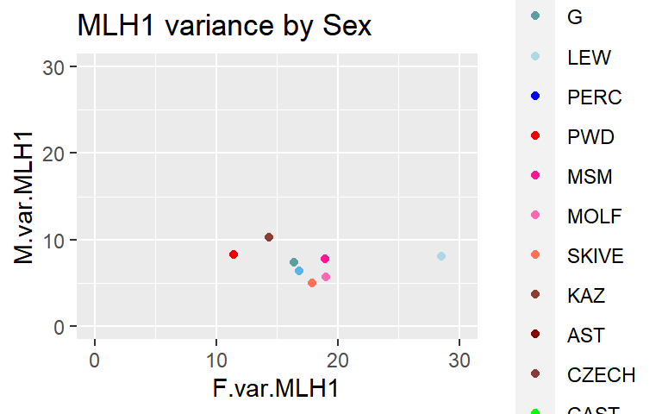
Chapter 3, Preliminary Results
Variation in recombination rate
Mean Recombination Rate
Notes:
Use the correlations of mean and variance to address the question of Does male specific evolution of RR effect the variance?
There is significant positive correlations but this is not driven by the high recombining males.
The between cell variance not influenced by mean in males, (mouse level and strain average).

Slide 16
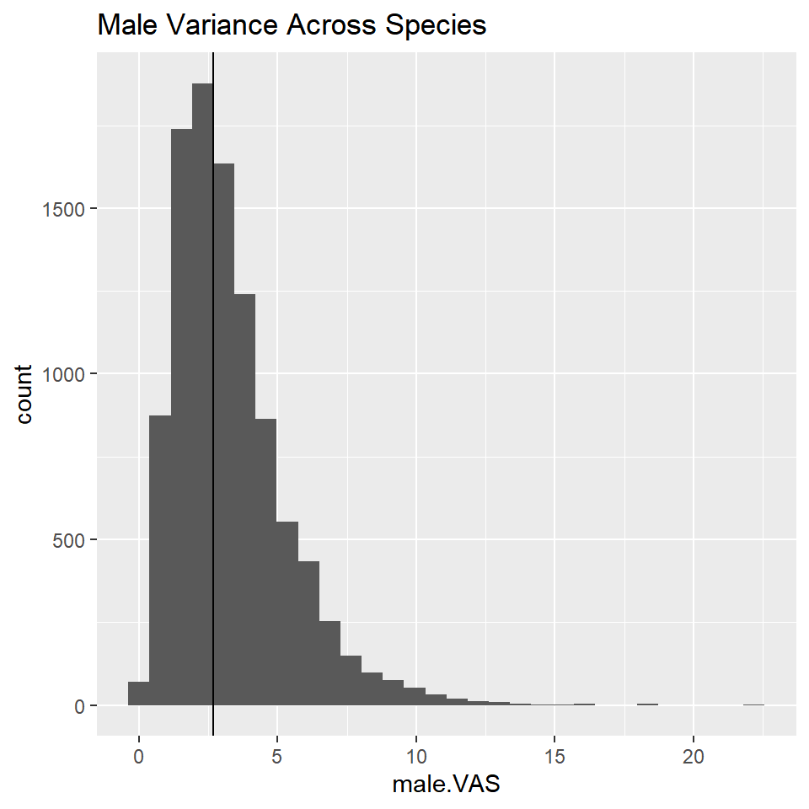
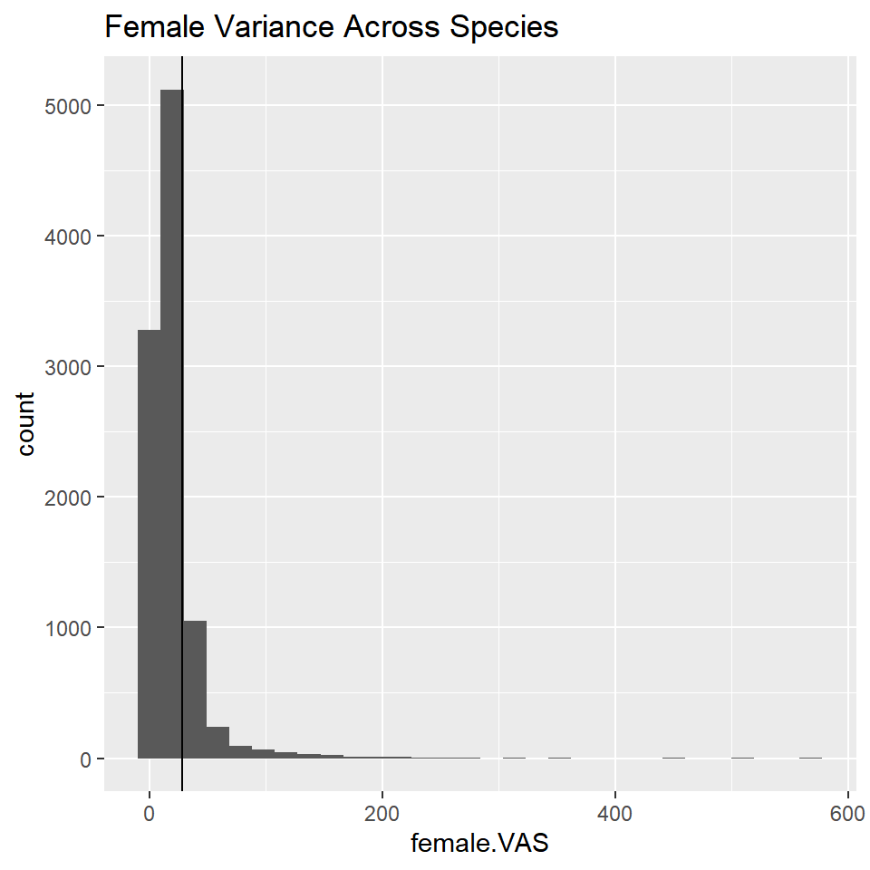
Chapter 3, Permutations
Male variance across strains
Female variance across strains
Sex specific variance across strains
Pool all cells within sex, randomize strain for the same number of MLH1 counts
Calculate the variance across ‘strains’
No evidence of strain effects for the observed variance across cells
n=10,000
p= 0.83
n=10,000
p= 0.46
Notes:
I ran permutations to test for effects from strains
Permutations 1 (strain effects would be detected here)
No evidence of strain effects. This means that Despite significant evolution in the gwRR in males for there strains, there is not detectable effect on the level of variance

Slide 17
Chapter 3, Preliminary Results
Strain Variance
Male
Strain Variance
Female
*no significant strain effects from glms
Notes:
This plot shows the strain levels variances by sex.
The direction is consistent, female variance is always larger, but the magnitude varies across strains.
This plot implies there has been evolution in variation female variation, but the glms fail to detect a difference. (Would be more informative to have the CIs)

Slide 18
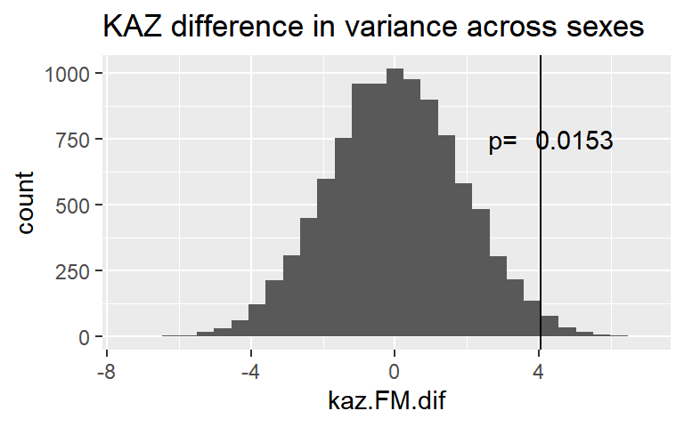
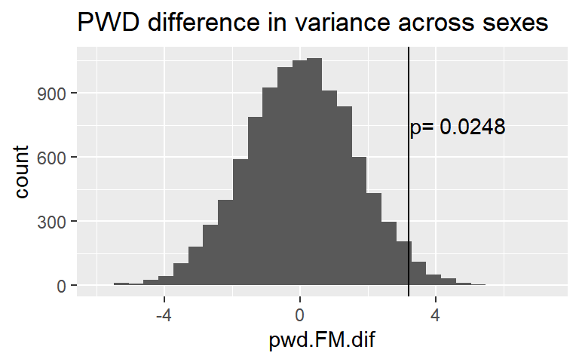
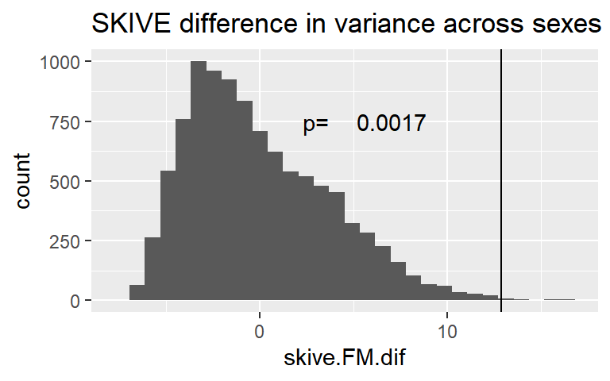
Chapter 3, Permutations
Strain specific sex difference in variance
Sex difference in variance within strains
Pool all cells within a strain, randomize sex
Calculate Female.var, male.var difference
Sex differences are significant for all strains
Notes:
Permutations set 2.
I permuted the effect of sex on variance for each strain individually
Sex effect on variance is conserved. Female’s have greater between cell variance for CO count compared to males)

Slide 19
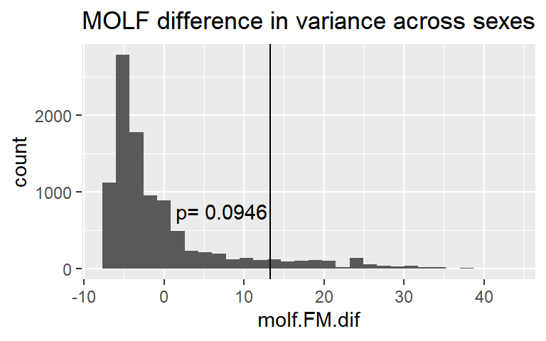
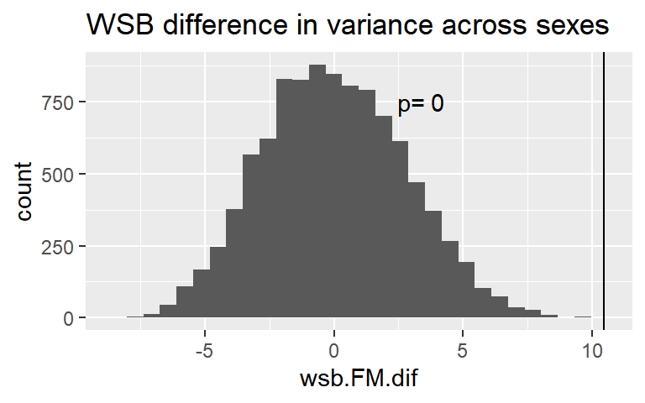
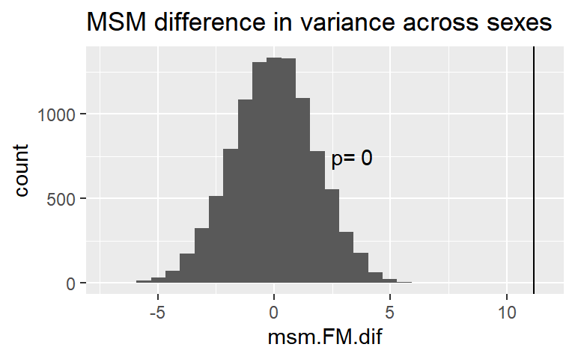
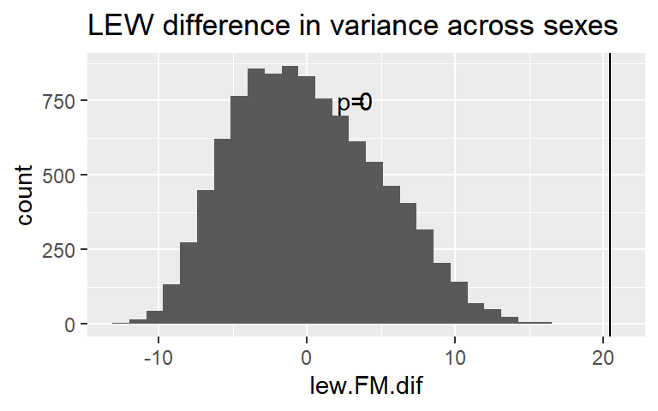
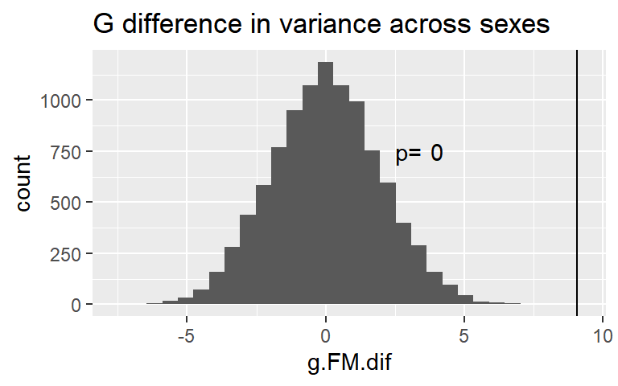

Slide 20
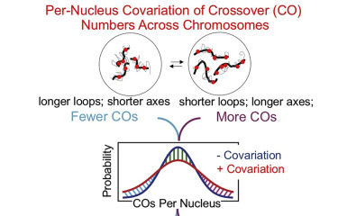
Connection to SC Axis Length
Chapter 2:
-Total SC measures are significantly higher in females
Chapter 3:
- glms results are inconsistent
- Total SC variance is not a good predictor for CO variance
https://www.sciencedirect.com/science/article/pii/S009286741930203X
Wang, Shunxin, et al. "Per-nucleus crossover covariation and implications for evolution." Cell 177.2 (2019): 326-338.
Examines cell variation in CO number (not in a sex specific manner), they propose that
Notes:
The variation of SC lengths are significant parameter for between cell variation in CO count. I would like to incorporate data on the SC length into chapter 3.
Wang et al proposes that the total variation / overdispersal of CO counts across cell is driven by the packing ratio of a cell.
The packing ratio refers to within cell correlation across bivalents of the loop-axis structure or (looping-factor) . Some cells have more COs because all of their SC are longer together.
I don’t have complete single bivalent data for each cell with complicates calculating within cell correlation because I cant exclude chromosome effects. Meaning total SC is best metric. However there are complications I still need to workout: different error structure for the data, algorithm performance, XY effect.

Slide 21
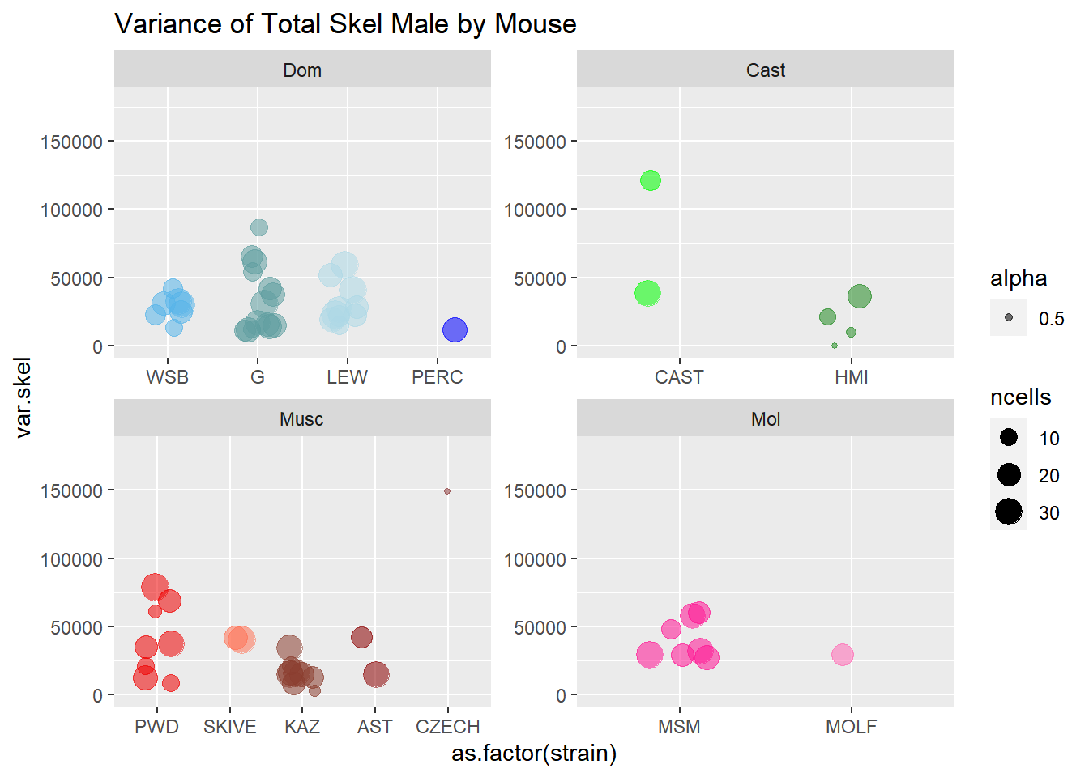
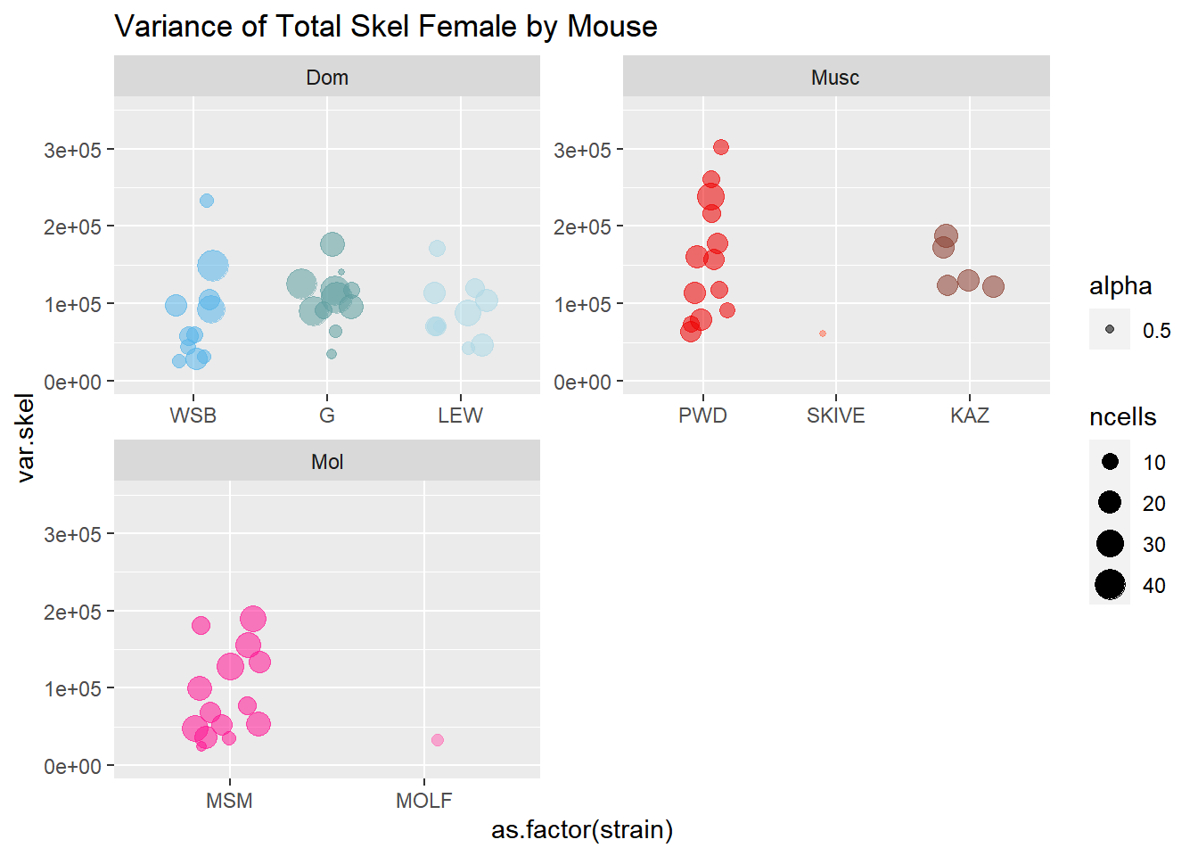
Chapter 3, Total SC Variation
Notes:
My interpretation for these SC variance are that there's weak evidence of sex effect and no evidence of direct connection to MLH1 variance. Glm models indicate that SC.var and MLH1.var both have a conserved sex effect. From the direct tests section, there's no evidence of causation, SC.var -> MLH1.var,
I plan to investigate this metric closer to see if it would be worth including in the manuscript.
My interpretation for the weak association between MLH1 mean and variance indicates that the meiotic 'regulation' for COs per cell is conserved across strains and inherently different between sexes.

Slide 22
Chapter 3, Current Plan
Working title: Genome-wide recombination rates are more variable in females
Main results: Between cell variation in recombination rate is a conserved sexually dimorphic trait.
Other topics
Mechanistic connections: acentriolar spindle and leaky SAC in females
Variance as a target of selection or pleiotropic?
Evolutionary consequences of sex differences in recombination rates
Notes:
1. Goal: short paper which examines sexual dimorphism in recombination rate variation from with an evolutionary perspective.
Most papers with single cell measures from both sexes examine the molecular and genetic pathway. Previous papers examine recombination rate variation within an evolutionary context, but without examining sex differences. Few papers look at short evolutionary scales.
My interpretation for the weak association between MLH1 mean and variance indicates that the meiotic 'regulation' for COs per cell is conserved across strains and inherently different between sexes.

Slide 23
Defense Timeline
June
Submit Chapter 2 (June 15th)
Finish analysis and Outline for Chapter 3 (June 26th)
July
Write and submit manuscript for Chapter 3
August-September
Write draft for thesis Intro and Discussion
October 2020
Final edits to thesis and defense
Notes:
Previously set an aggressive timeline for defending by the end of summer term. I recognize now that might not be achievable. I’ve updated to a defense date that might be more reasonable.
Chapter 2 is at strong position. I just need to write intro and abstract.

Slide 25
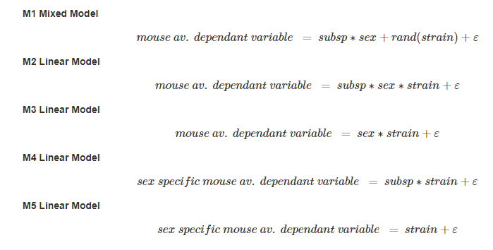
Notes:
Model formula for chapters 2 and 3

Slide 26
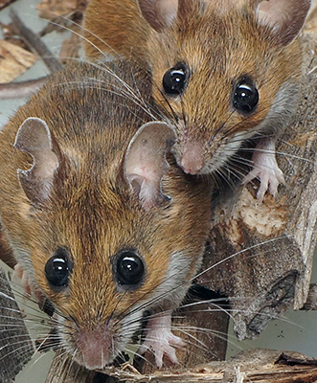
Conservation of the genome-wide recombination rate in white-footed mice
- Estimates of genome-wide recombination rates (gwRRs) from mice in a natural population -- compared to lab raised mice
- no evidence of difference between wild and lab raised gwRRs
-Fits a model of stabilizing selection acting on the male-specific gwRR.
(other estimates of gwRR from natural populations)
-D.psudobscura (directional / adaptation)
-Soay Sheep (Heterochiasmy / male-biased?)
-Red Deer (?)
Dr. Gabor Szalai and Janet Crossland,
Peromyscus Stock Center
Notes:
My first chapter was published last year
I’ll just give the brief highlights
-I quantified the genome wide recombination rates of wild caught and lab raise Peromycus leucopus and lab raised Peromyscus maniculatus baridii
-all mouse gwRR were all very close to the expected minimum of 1 CO per chrm
-While some mice varied significantly from each other, the groups of wild and lab raised mice did not show a significant difference in gwRRs.
We interpreted these results as support for stabilizing selection acting on the male gwRR in this natural population.
-joins other estimates gwRR for natural populations
Samuk – Dspudo, Jonston Soay sheep
-- lays the base for understanding the evolution of this important trait in nature.

Slide 27
Distinct evolutionary trajectories
Genome wide recombination rates
Mammals
Female Recombination Rate (cM)
M.m.
molossinus
M.m.
domesticus
M.m.
musculus
Data from Lenormand and Duthiel, 2005 and Brandvain and Coop 2012.
Male Recombination Rate (cM)
Notes:
Sex is crucial factor when considering variation in recombination rates. My results emphasize that the genome wide recombination rates experience distinct evolutionary trajectories.
<explain plot>

Slide 28
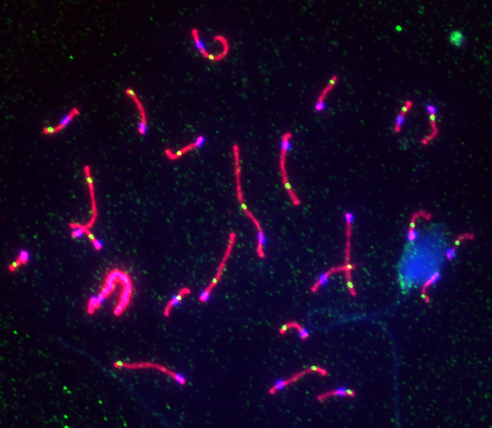
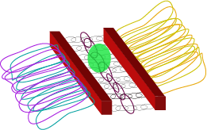
Quantifying recombination and meiotic traits
CO Counts
(Automated tool DNA.Crossover)
2. Single chromosome patterns
Length of Synaptonemal Complex
Position of COs
Synaptonemal Complex (SC)
23 CO
MLH1 (CO repair protein)
Homologous chromosomes
Notes:
(outline the approach I use, single cell cytological marker of COs, for my thesis.
Main plus is that it allows – easy estimation of genome wide recombination rate for individuals.
Also, in addition to CO counts / rates, provides information for the molecular pathway.
(genome wide recombination rate – is made up of individual chromosomes – so visualizing all chromosomes of the genome –
(single bivalent observations are (( let you track patterns which might shed insight on how the genome wide RR proceeds.
1.
I use 2 metric for characterizing recombination rates in single cells. The first is counting CO markers
The second is looking at the recombination patterns of single chromsomes; specifically the length of the SC and position of COs.
2. (I’ll explain a bit more of the structure that is being visualized;
(main feature is a str called the Synaptonemal Complex. This cartoon in the corner illustrate a few of the components that make up the SC. The actual DNA of the chromosomes is not visualized in my data,
But because of the (organization) – the SC serves as a proxy--
the chromosomes is arranged into chromatin loops enemanating from the SC / chromosome axis. (So the actual DNA
We use the staining methods to visualize Crossovers, the centromeres, and This (other diagram shows part of the finer structure of the SC. It marks the boundary between the homologous chromosomes where – keeps them aligned. And this area is where DSBs are repaired (into COs or NCOs)
)
2 patterns on single bivalents. Since the gw –rate is a composite of single chromosomes we wanted to examine the patterns of single bivalents.
3. These are the elements we stain for in the cells; MLH1, SC centromere
(this SC cartoon illustrates the str (can’t see the DNA loops in these cell spreads – just see parts of the SC – axis)
Some Caveats come with this method
Only // focus on male tissue
We stain for just Type I COs, Missing Type II COs (~10% in most mammals)
Technical noise (quality of the cell spreads)

